Slide 1
Conjectures and Counter-Examples
Centering Student Thinking
Using
Genuine Mathematical Conversations
Paul Gafni
National Council of Teachers of Mathematics
Boston, 2019
Grades 2 and up!

Slide 2
Objectives
-Get you using Conjectures and Counter-Examples
-Empower you to put this in students’ hands on Monday!
Conjectures and Counter-Examples:
Centering Student Thinking Using Genuine Mathematical Conversations
Paul Gafni
National Council of Teachers of Mathematics
Grades 2 and up!

Slide 3
Conjectures and Counter-Examples:
Centering Student Thinking Using Genuine Mathematical Conversations
What are Conjectures and Counter-Examples?
Conjecture: Everything that can fly is a bird.
Counter-examples:
Planes
Helicopters
Mosquitos
Space ships
Penguins?
Conjecture: Everything with legs can walk.
Counter-examples:
Chairs
Tables
Wine
Babies

Slide 4
Conjectures and Counter-Examples:
Centering Student Thinking Using Genuine Mathematical Conversations
A Classic Problem
The Process
An Example
Pick a positive integer.
Let’s try 16
Add all its factors, not including the number itself.
1 + 2 + 4 + 8 = 15
Repeat the process with the resultant number.
1 + 3 + 5 = 9
1 + 3 = 4
What do you notice?
1 + 2 = 3
What do you wonder?
What do you want to try next?

Slide 5
Conjectures and Counter-Examples:
Centering Student Thinking Using Genuine Mathematical Conversations
A Classic Problem
Play around with it for a couple minutes.
Maybe try a couple other numbers to test some things…
Feel free to chat about what you find.

Slide 6
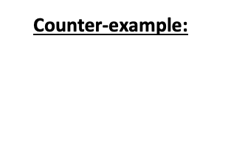
Conjectures and Counter-Examples:
Centering Student Thinking Using Genuine Mathematical Conversations
In My Classroom

Slide 7
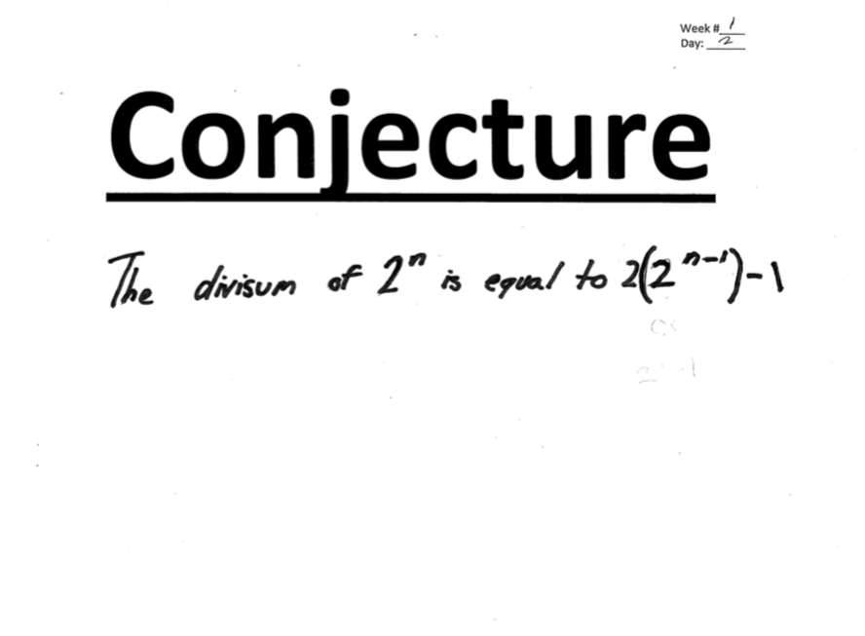
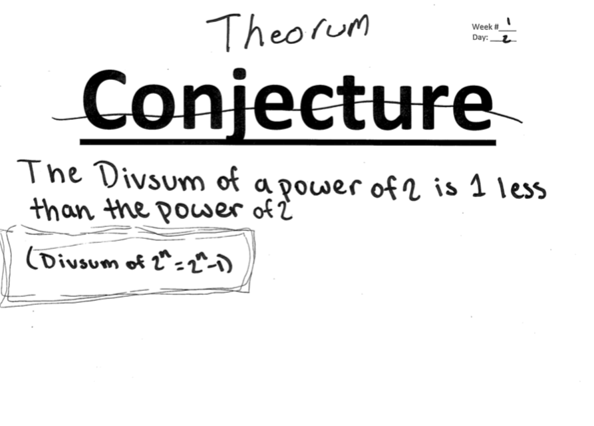
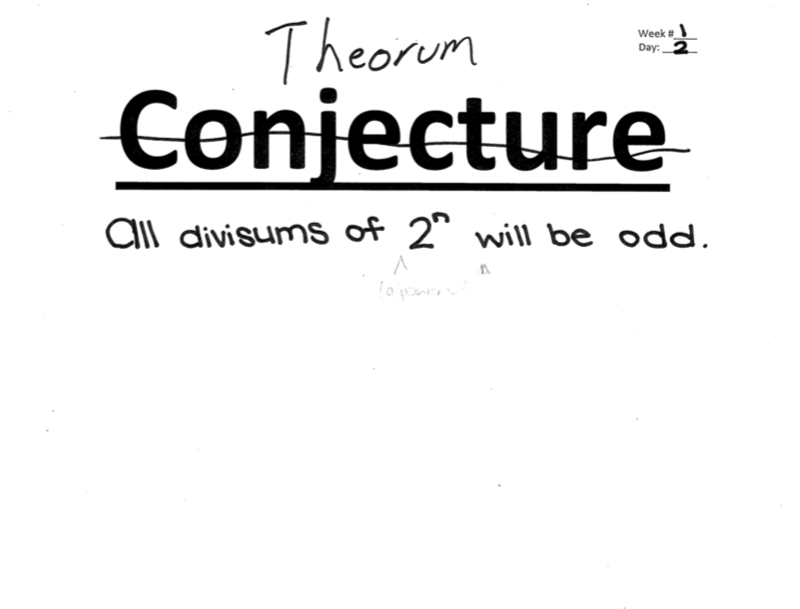
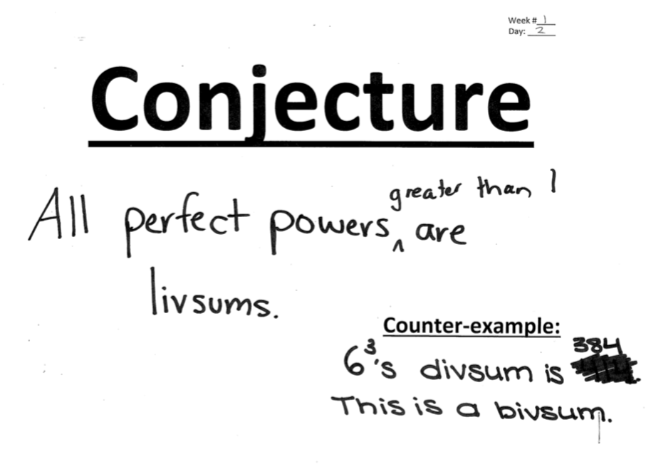
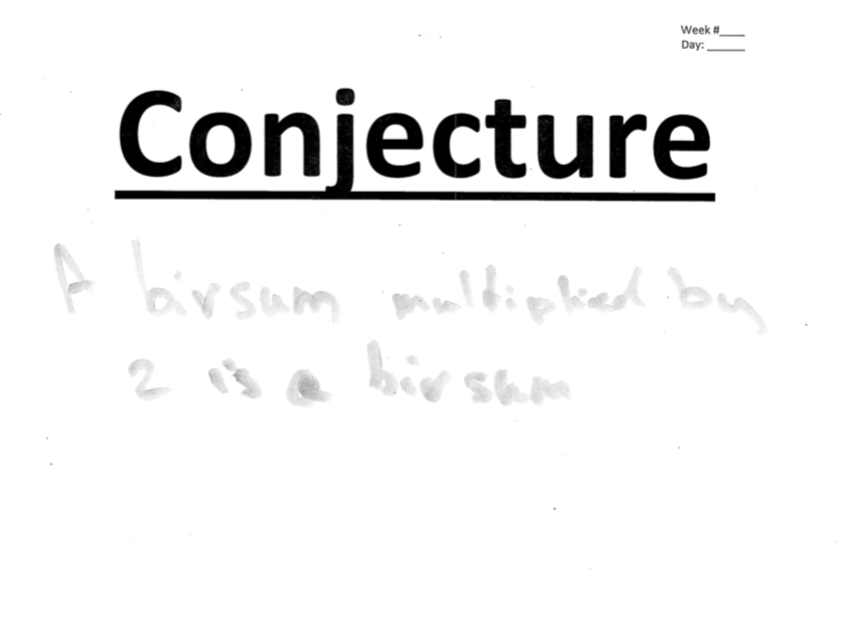
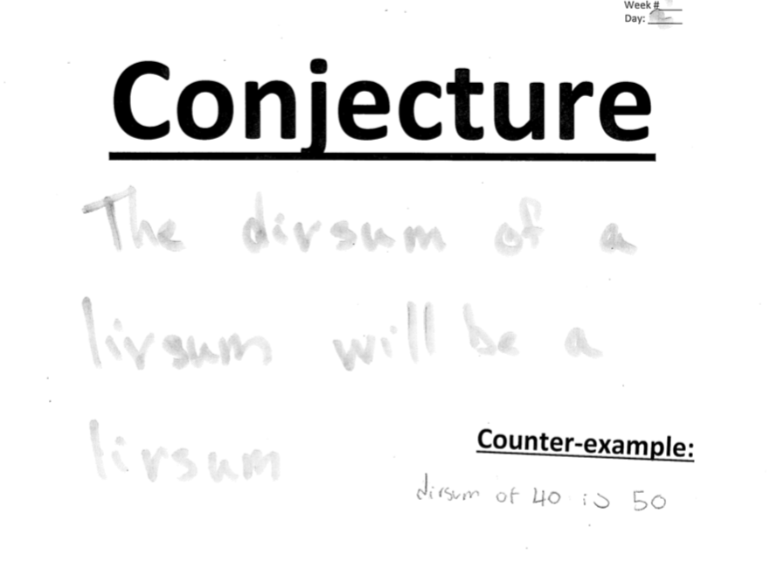
Conjectures and Counter-Examples:
Centering Student Thinking Using Genuine Mathematical Conversations
Any Conjectures?

Slide 8
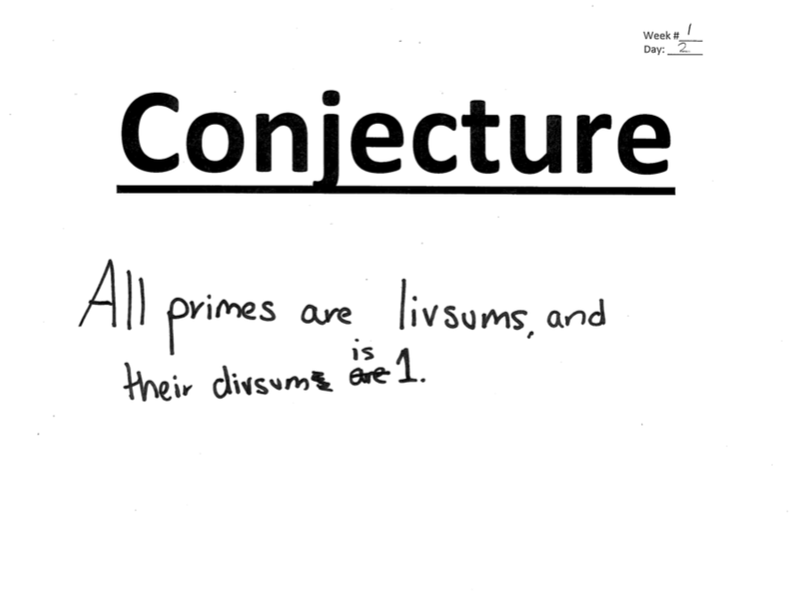
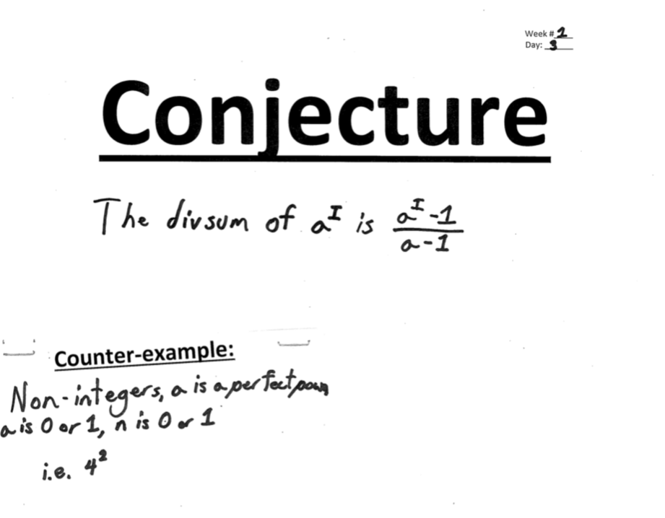
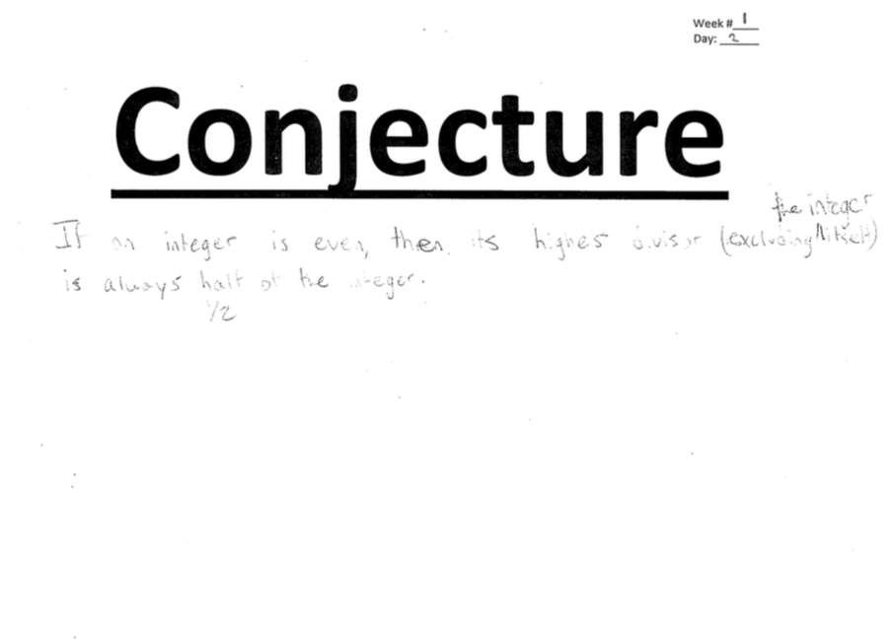
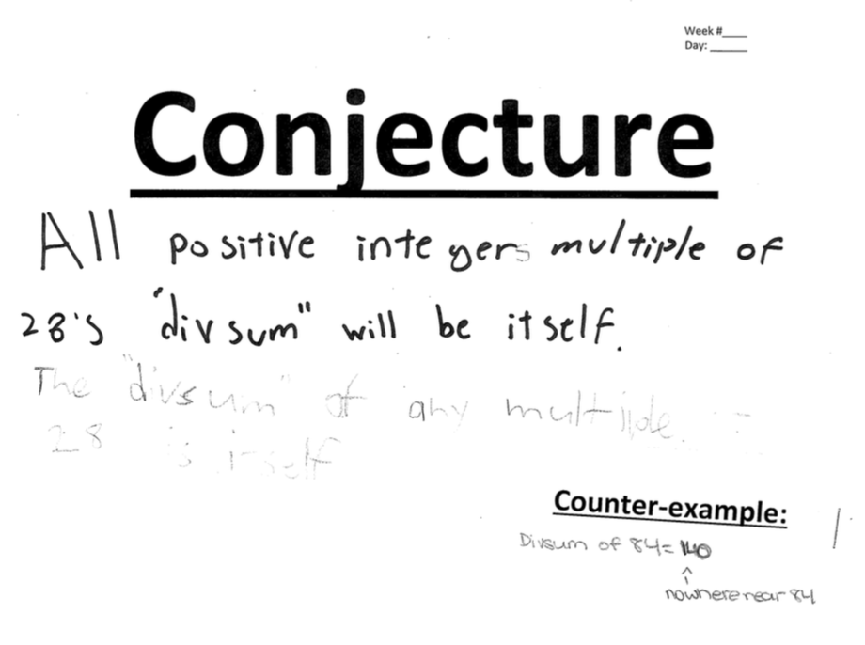
Conjectures and Counter-Examples:
Centering Student Thinking Using Genuine Mathematical Conversations
Low Floors, High Ceilings

Slide 9
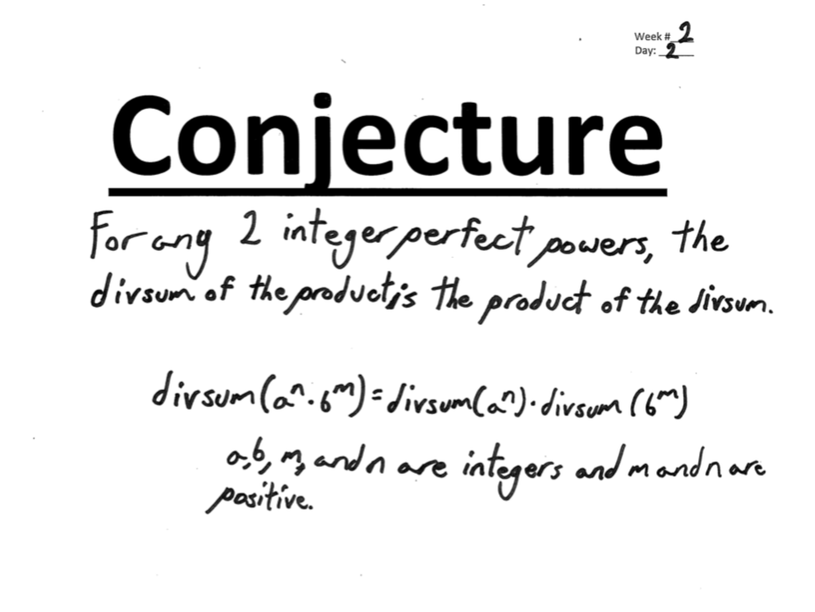
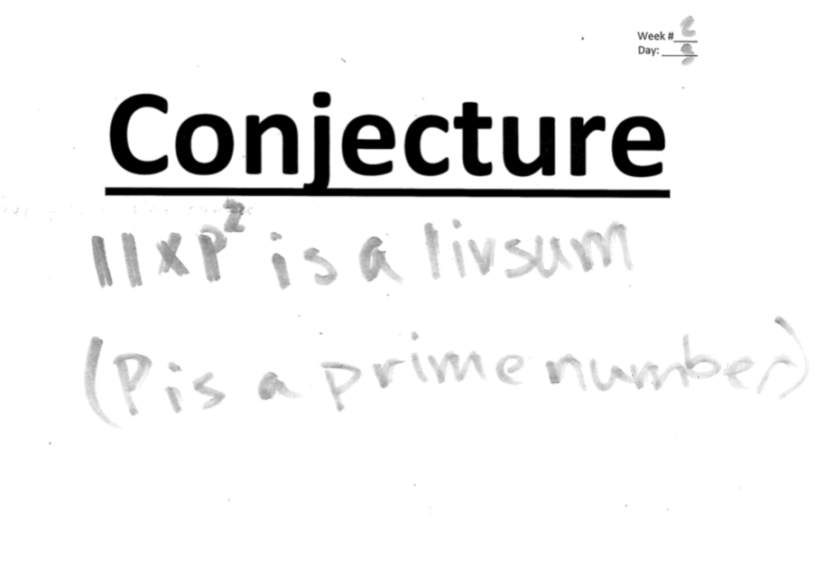
Conjectures and Counter-Examples:
Centering Student Thinking Using Genuine Mathematical Conversations
While the Rest of Us Had Moved on…

Slide 10





Conjectures and Counter-Examples:
Centering Student Thinking Using Genuine Mathematical Conversations
Overheard in the Classroom
Wait, I noticed something about 3rd powers…
Look:
125 → 1 + 5 + 25
I have a conjecture!
8 → 1 + 2 + 4
$$n^{3}→1+n+n^{2} ??$$
27 → 1 + 3 + 9
Wait, didn’t we learn a formula for $1+n+n^{2}$ ?
What was it called? Geometric Series or something like that?
Ooh—ooh, it works for 4th powers too!
625 → 1 + 5 + 25 + 125
81 → 1 + 3 + 9 + 27
So can we say $n^{4}→1+n+n^{2}+n^{3} ?$
Oh no! Isn’t 64 a Counter-Example? It’s $4^{3}$ but it’s got way more factors than $3^{3}$ or $5^{3}$
OK, I guess it’s only when $n$ is odd.
But… it worked for $n=2$, didn’t it?

Slide 11
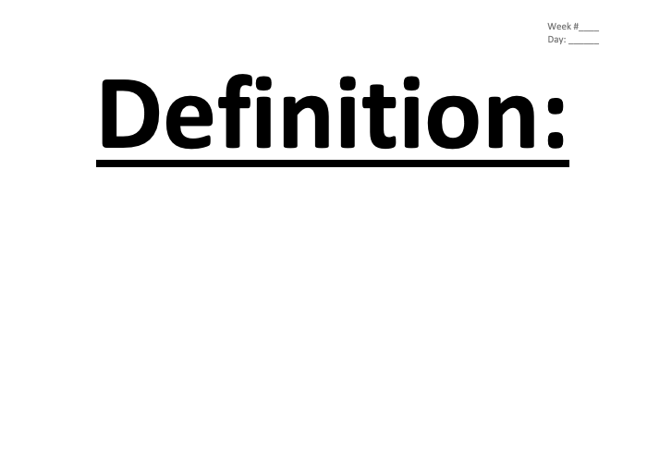




Conjectures and Counter-Examples:
Centering Student Thinking Using Genuine Mathematical Conversations
Adding Rigor with Definitions
Let’s use the function f to describe this process.
So, we have $f\left(16\right)=15$
$f\left(15\right)=9$
$f\left(9\right) =4$
And so on
And, let’s introduce some definitions in order to simplify things a bit further…
Definition: We call $n$ perfect if $f\left(n\right)=n.$
Definition: We call $n$ abundant if $f\left(n\right)>n.$
Definition: We call $n$ deficient if $f\left(n\right)<n.$

Slide 12
Conjectures and Counter-Examples:
Centering Student Thinking Using Genuine Mathematical Conversations
In Your Classroom
Take a minute to think about how this might look in your classroom.
What obstacles do you see?
Turn to a neighbor and discuss.

Slide 13
Conjectures and Counter-Examples
Centering Student Thinking Using Genuine Mathematical Conversations
Questions?
Global Math Week is October 10-17!
Join in on the fun!
Where can I find problems like this?
James Tanton – Exploding Dots
Thinking Mathematics Vol 1
Without Words
Math for Love
Julia Robinson Mathematics Festival Problems
Math Circle resources… Circle in a Box, for example
Paul Gafni
Paul.gafni@gmail.com
Sunil Singh – Math Recess

