Slide 1
Removing the Ceiling
Empowering Highly Capable Middle/High School Students with Extended Math Writing Assignments
Paul Gafni
NAGC. Charlotte, NC
November 2017
My Other Presentations
Graphing Challenge Poster Sat 12-1 Poster 32
Critical Thinking in Design Sat 1:15-2:15 Room 212A
(Laser cutting/3D Printing)

Slide 2
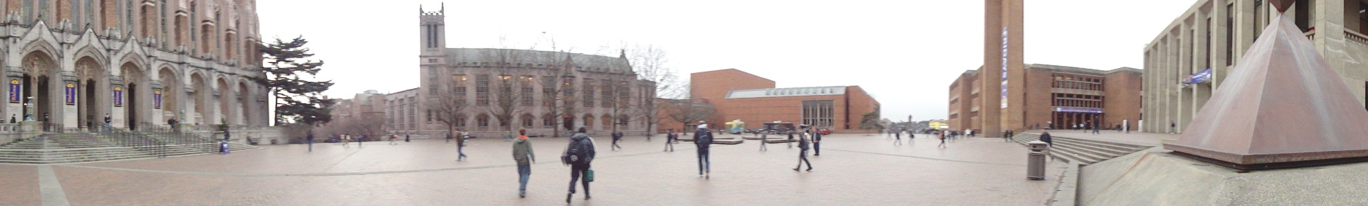
Robinson Center for young scholars
Early Admittance Programs to University of Washington
Transition School/Early Entrance (EEP): 13-14 years old
UW Academy – 15 years old
Saturday Enrichment Program
Summer Challenge and Summer Stretch Programs
On-line Program
Notes:
2

Slide 3

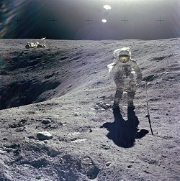
Imposing ceilings
Notes:
Almost all of the mathematical work we’re used to gives students a clear point at which they can say, “I’m done.” This endpoint serves as an imposed ceiling on student learning, particularly among the highly capable members of a differentiated classroom. Students who breeze through their math homework in a few minutes are deprived of a healthy mathematical struggle.
I argue that students should also be asked to do work that doesn’t include such a clear endpoint. This gives students the freedom to continue learning without an artificial finish line.
3

Slide 4
Pique student curiosity
45
+ 54
99
57
+ 75
132
+ 231
363
39
+ 93
132
+ 231
363
45: 1 Step Palindrome
57: 2 Step Palindrome
39: 2 Step Palindrome
11: 0 Step Palindrome

Slide 5
Prompt student inquiry
What do you notice?
What do you wonder?
Notes:
5

Slide 6
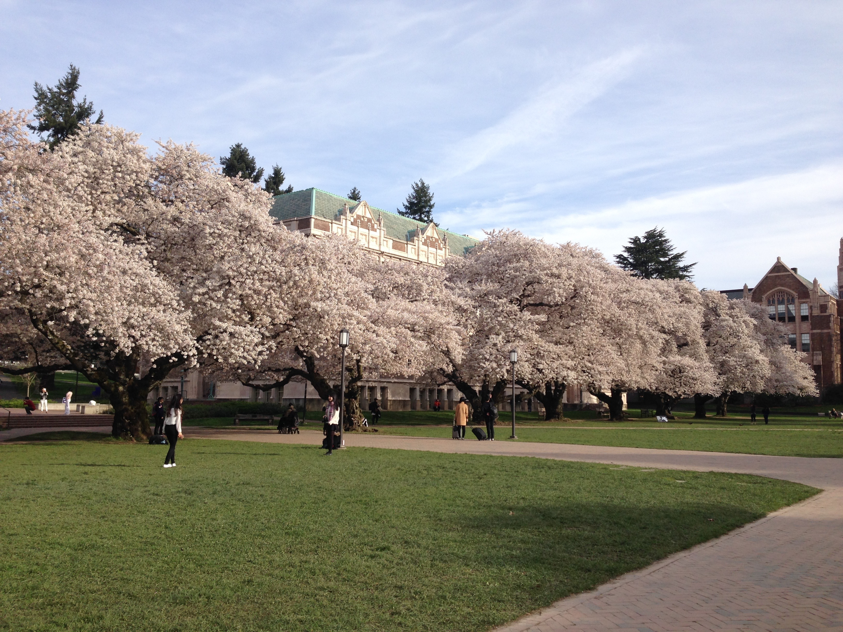
Emphasis on communication
Notes:
In framing these assignments, I emphasize over and over again that students are welcome to choose how deep they want to dive. Students are not expected to completely solve these problems; oftentimes there may be open problems around, and other times a complete solution would be more appropriate for an undergraduate thesis.
Instead, students are asked to:
-effectively communicate the scenario they are analyzing
-effectively describe the scope of their analysis—which aspects of the scenario will you consider, and which parts will you omit?
-effectively organize their work. I emphasize clear roadmapping and signposting in particular; I want their introductions to very clearly delineate what they will do and what order they will do it.
-effectively integrate mathematics into their writing. Variables and other mathematical notation needs to be introduced clearly and should be fluidly woven into their work.
6

Slide 7
Writing objectives
Clearly communicate the problem/scenario
Clearly communicate what the paper accomplishes.
Scope of analysis
What would motivate others to read this?
Clearly communicate the organization of the paper
Roadmapping
Signposting
Effectively weave mathematical symbols and notation into writing
Effectively writing about deductive reasoning

Slide 8
Student samples
Is the “palindrome process” explained clearly?
Is the intent/direction of the paper established?
Does the notation increase clarity?
Are the sentences understandable?

Slide 9
Typesetting Mathematics
LaTeX
  www.sharelatex.com
  Art of Problem Solving LaTeX Wiki
  Google and Stack Exchange to learn LaTeX
HTML and LaTeX

Slide 10
In my class
Generating curiosity
Constrained freedom
Stepping back and letting students struggle

Slide 11
In your class…
How do you imagine this fitting in to your classroom?
What obstacles do you foresee, either for you or your students?

Slide 12
Student Struggles and
Implementation Challenges
Finding an interesting scenario
Carving out an appropriate scope
Differentiating between description and analysis
Writing understandable sentences
Writing understandable paragraphs

Slide 13
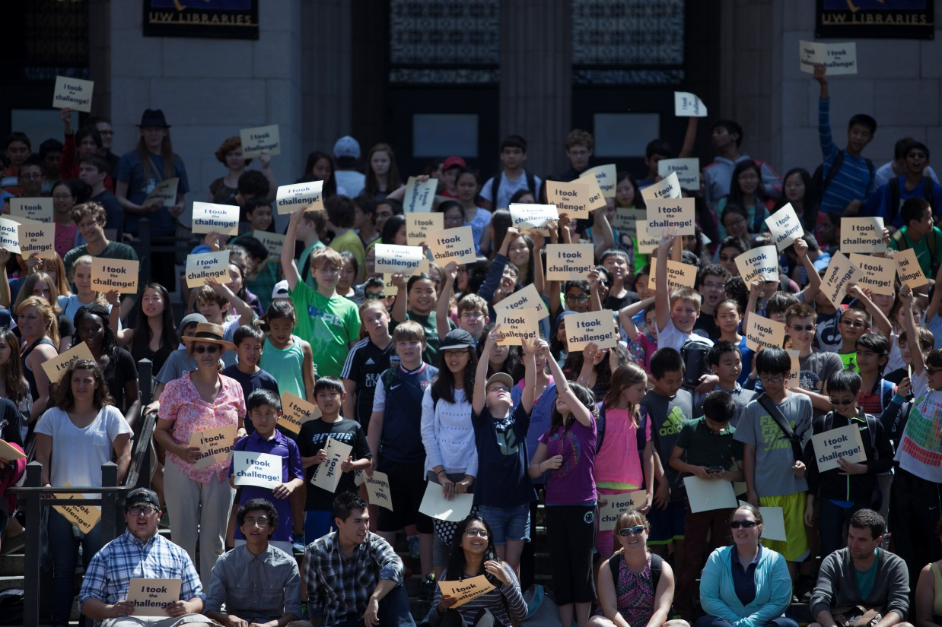
Check us out online!
http://robinsoncenter.uw.edu

Slide 14
Questions?
Paul Gafni
Gafnip@uw.edu
Transition School Mathematics Instructor
Robinson Center for Young Scholars
RobinsonCenter.uw.edu

