Slide 1
Critical Thinking in Design
A Hands on Introduction to Software for Laser Cutting, 3D Printing, and More
Paul Gafni
NAGC. Charlotte, NC
November 2017
Notes:
If WIFI: encourage participants to download and install Rhino.
If no WIFI: delete bottom two lines.
Next slide is RC background info

Slide 2
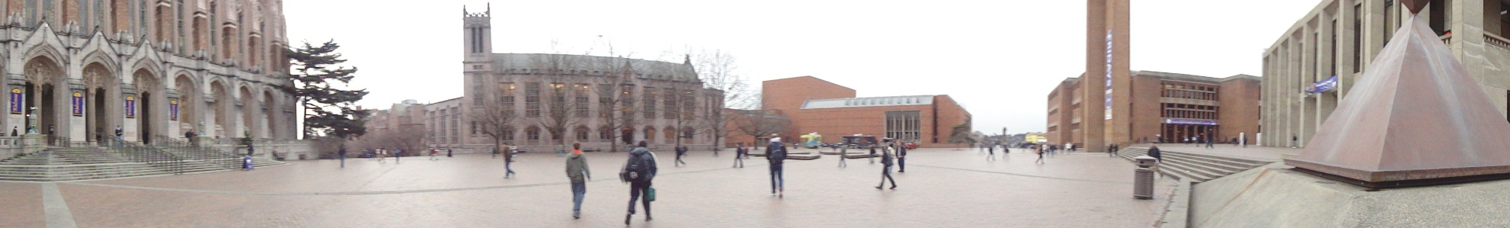
Robinson Center for young scholars
Early Admittance Programs to University of Washington
Transition School/Early Entrance (EEP): 13-14 years old
UW Academy – 15 years old
Saturday Enrichment Program
Summer Challenge and Summer Stretch Programs
On-line Program
Notes:
Next slide introduces my mathematical art.
2

Slide 3
My mathematical art
Notes:
3

Slide 4
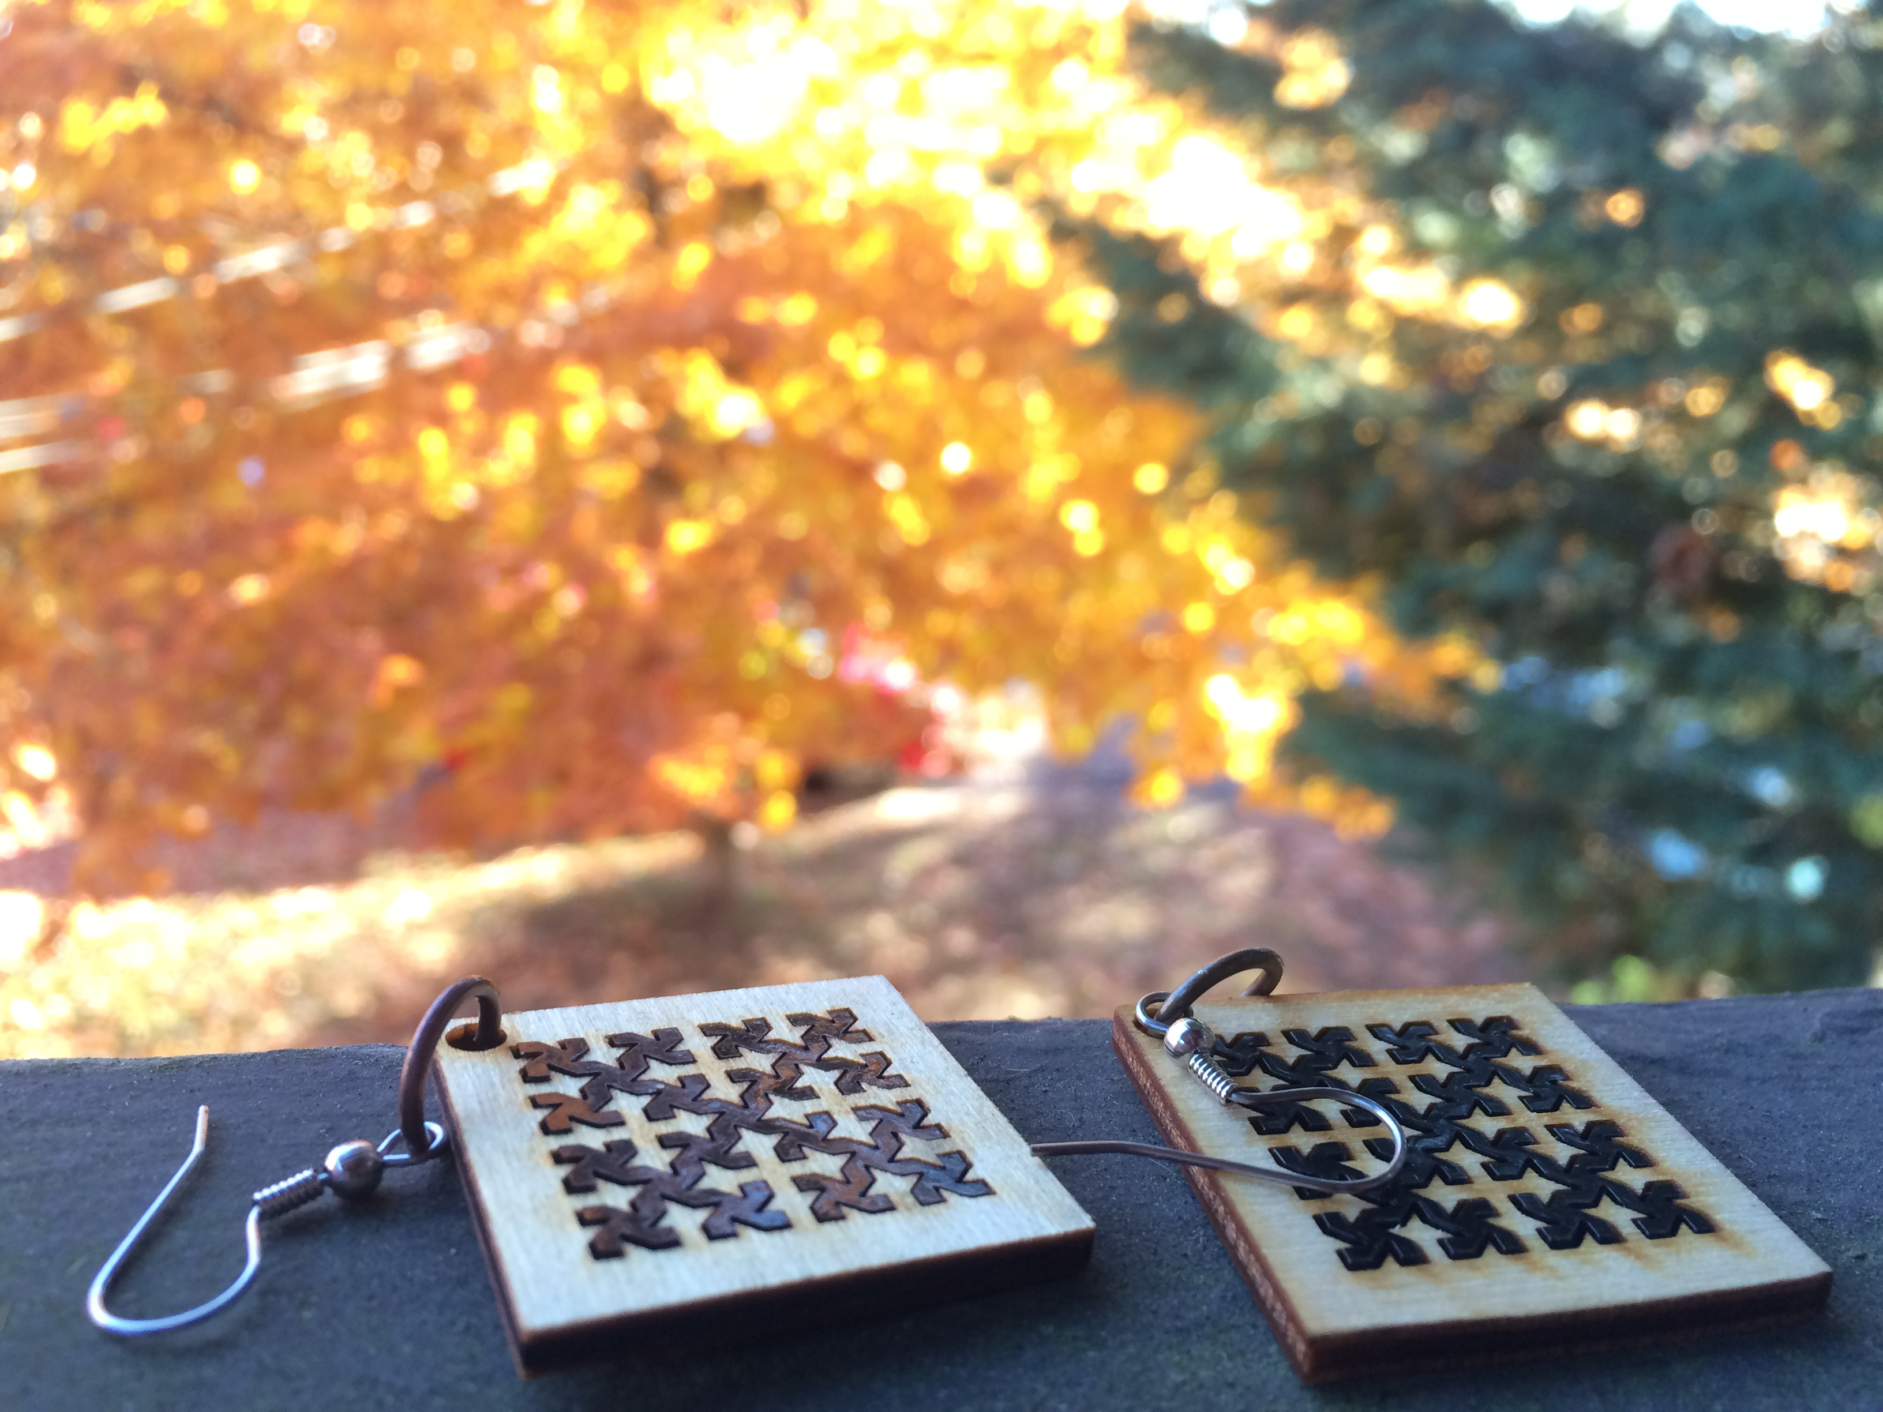
Notes:
Next slide is shield. Make note that these two designs will pop up again later.

Slide 5
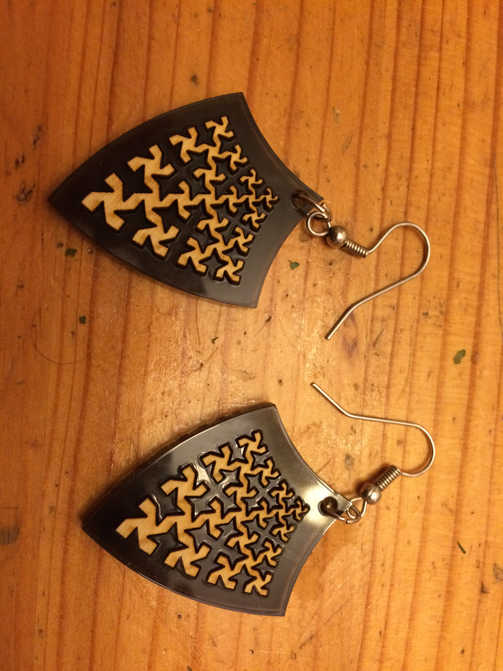
Notes:
Next is logarithmic scaling in white

Slide 6
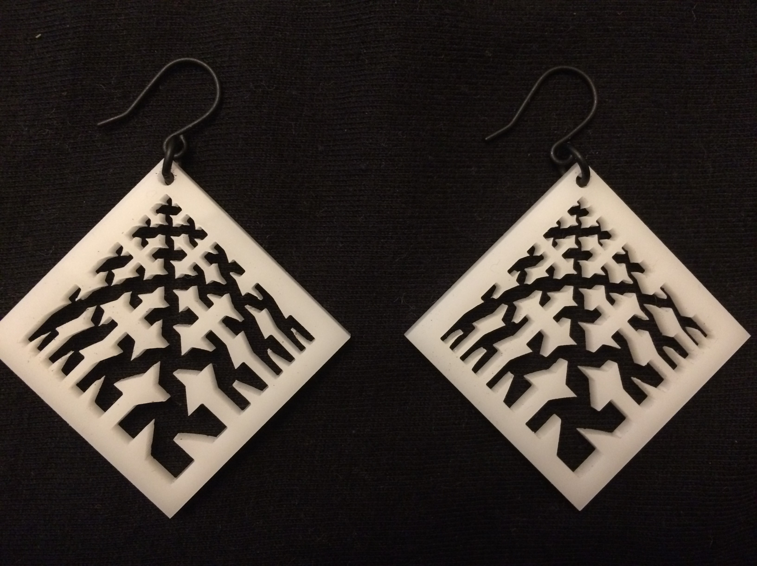
Notes:
Next is swirly

Slide 7
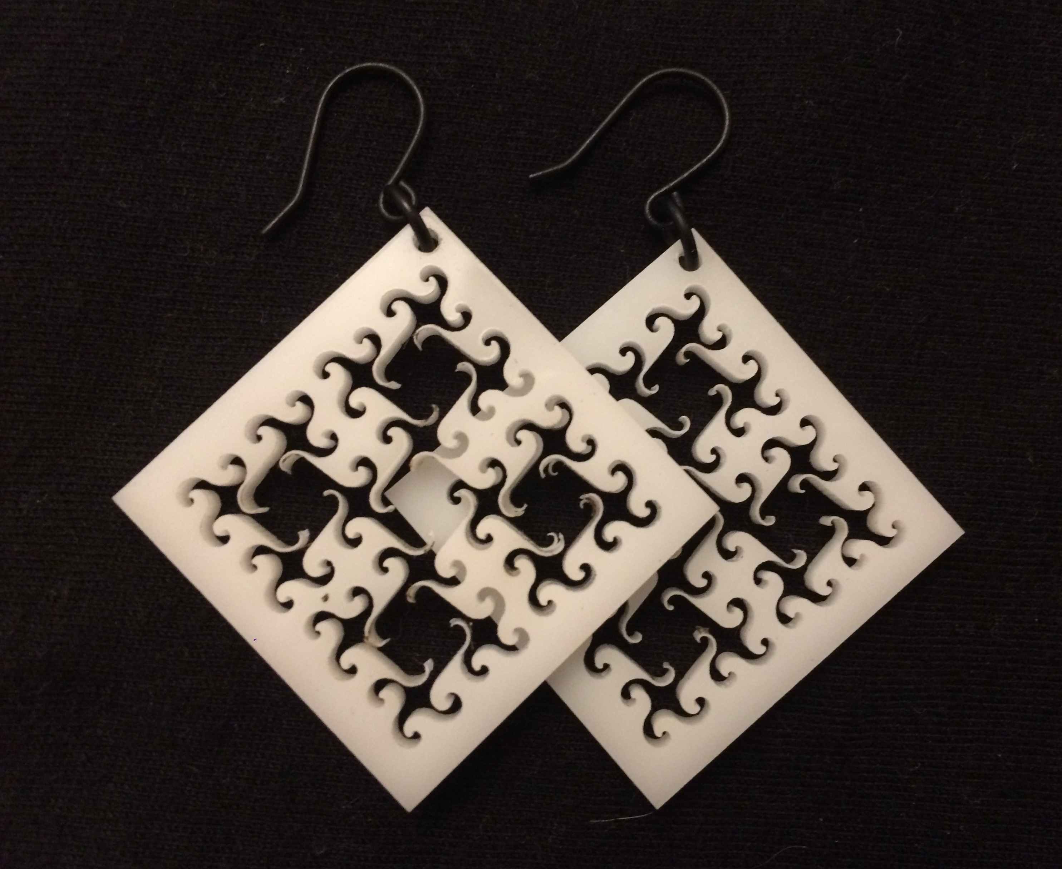
Notes:
Next is black and white circles

Slide 8
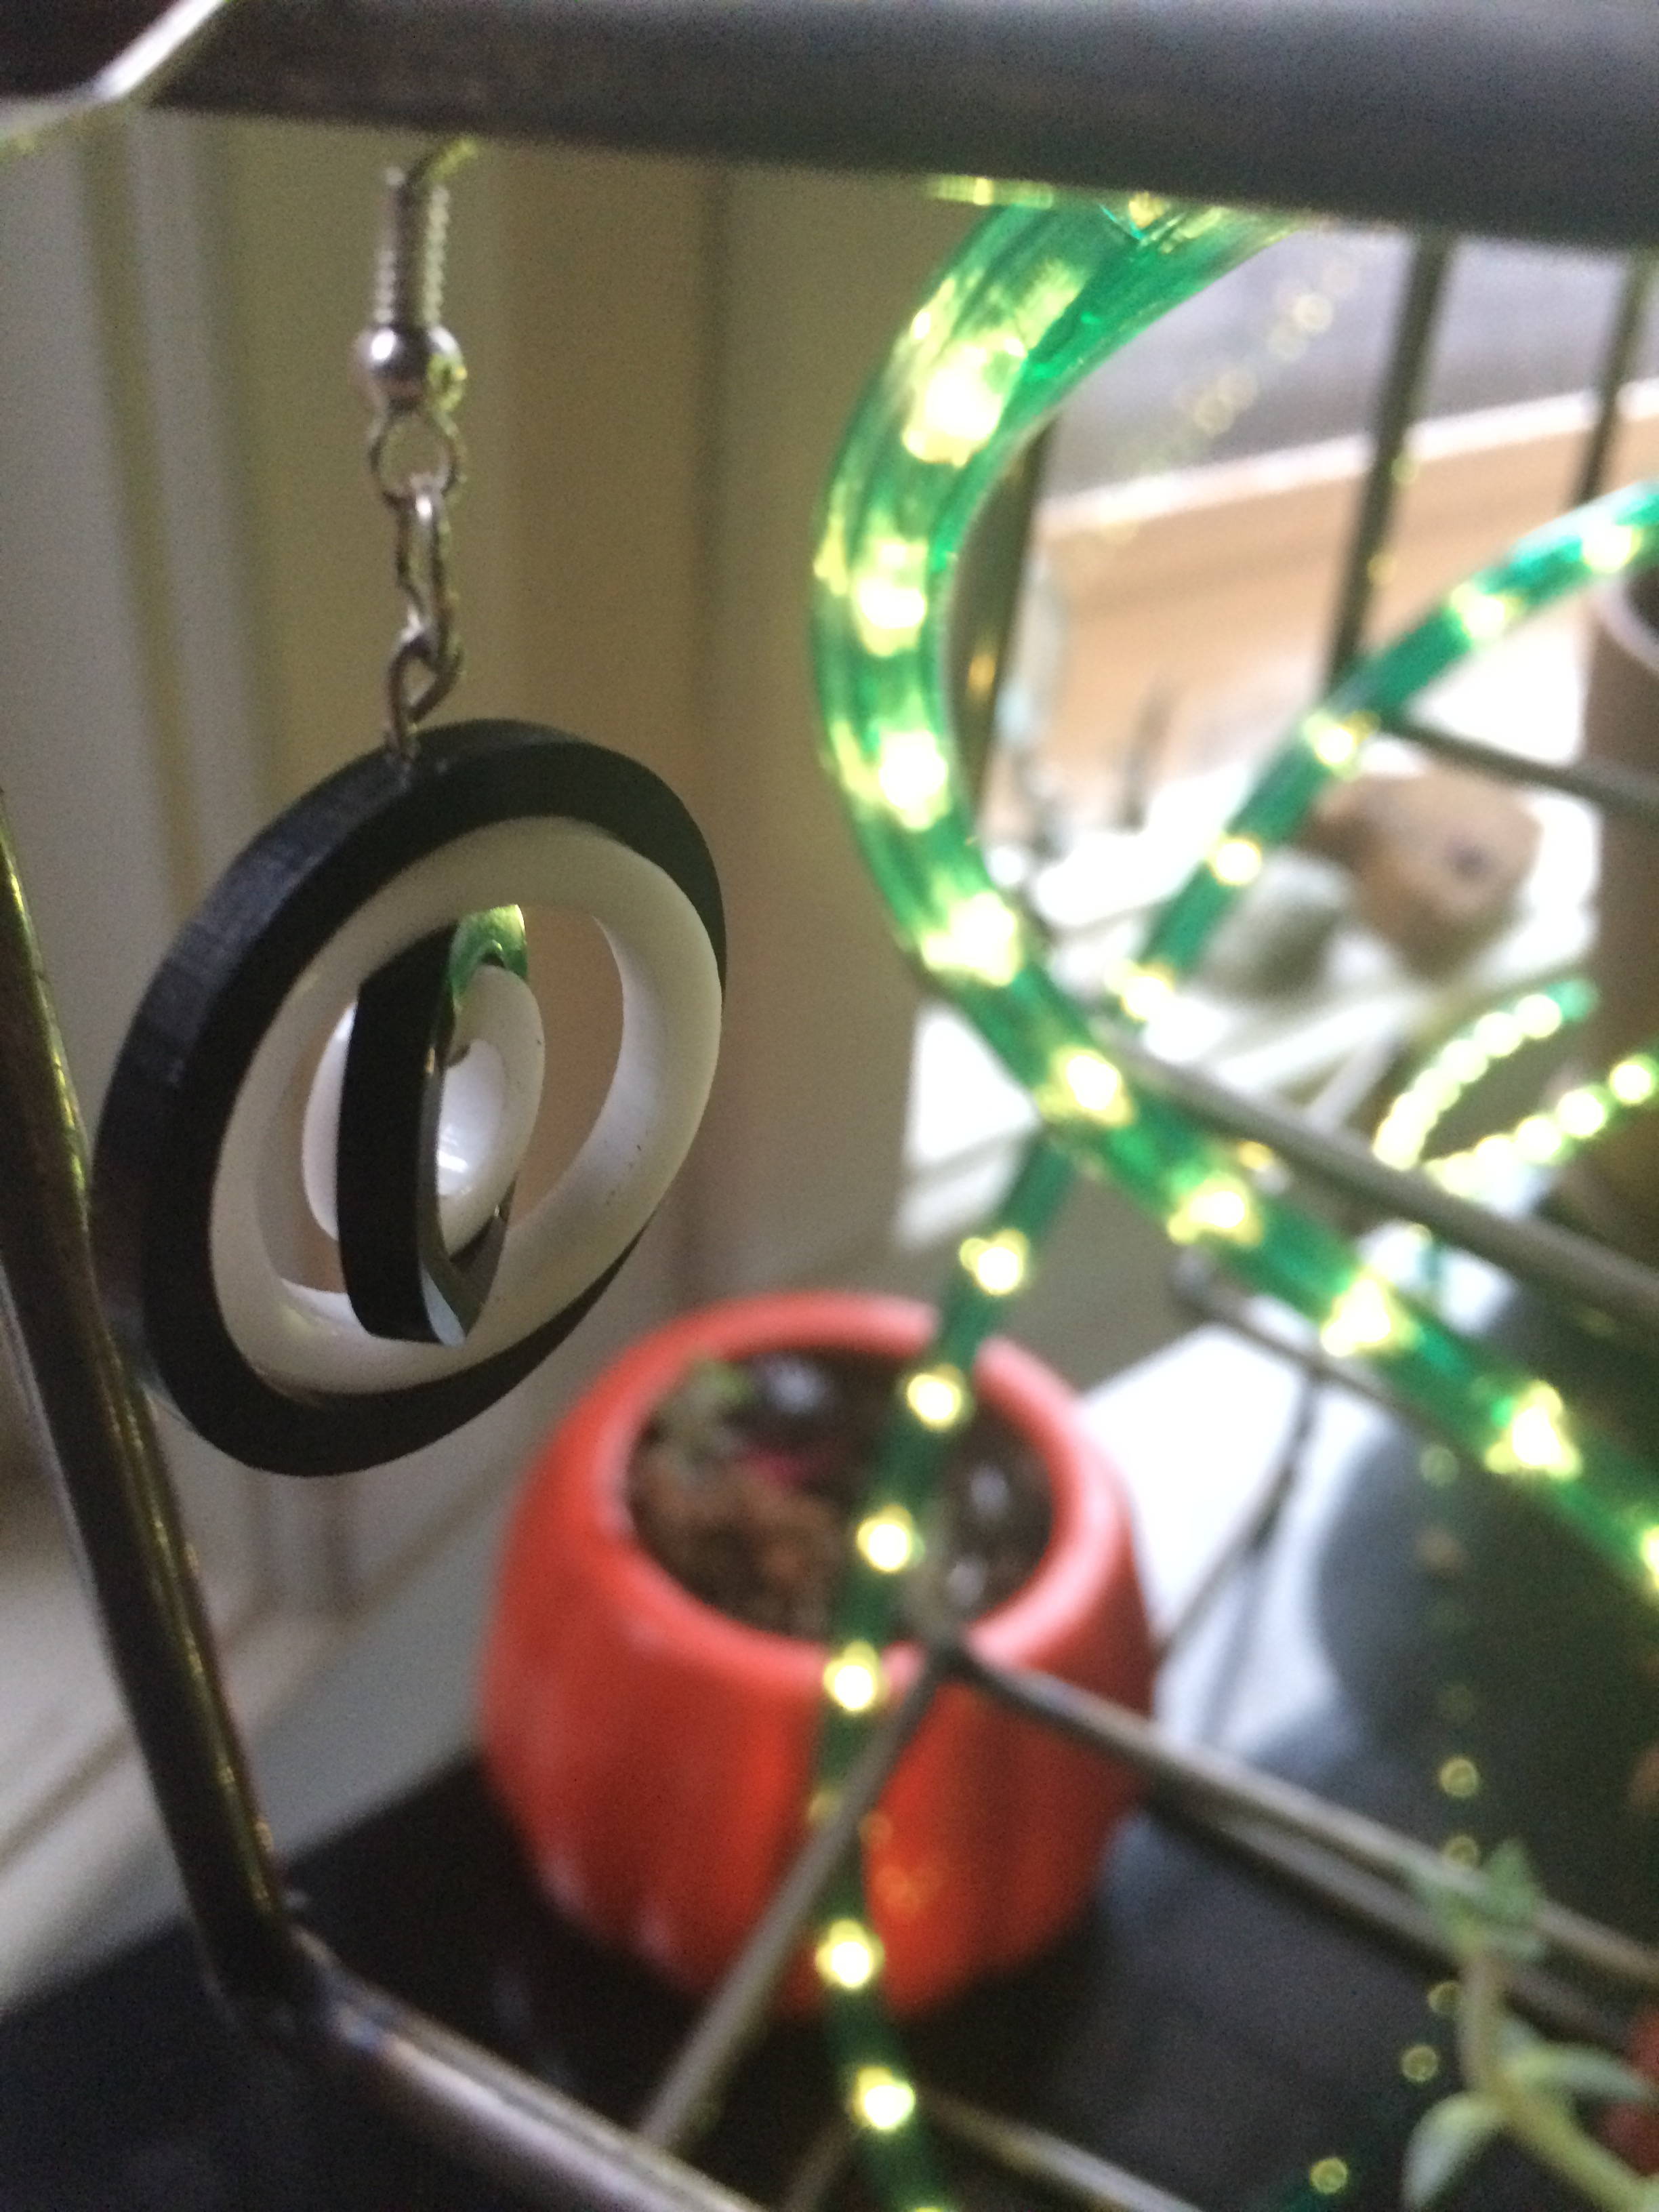
Notes:
Next is student art

Slide 9
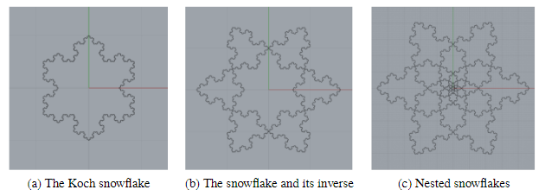
Student Designed Art

Slide 10
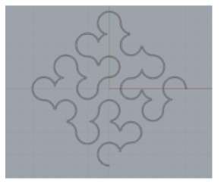
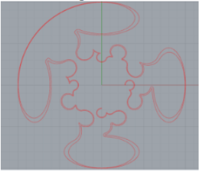
Student Designed Art

Slide 11
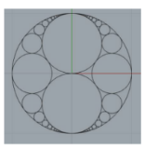
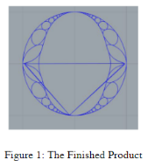
Student Designed Art

Slide 12
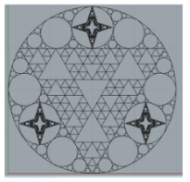
Student Designed Art

Slide 13
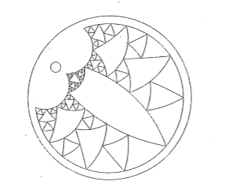
Student Designed Art

Slide 14
introductions
In groups of 2 or 3, introduce yourselves.
  Are you a teacher? Administrator? Parent?
    Do you have any experience with laser cutting, 3D printing, or CAD software?
      What are your goals in attending this session?
Notes:
14

Slide 15
objectives
Get acquainted with design software.
  Address school implementation questions.
Notes:
15

Slide 16
In your school...
What do you see as the major obstacles to doing this in your school?
            Budget Constraints
            Access to Equipment
            Access to Software
            Time/Bandwidth
            Lack of Expertise
Notes:
16

Slide 17
Affordable Fabrication
Outsourcing fabrication can cost as little as $1-2 per piece.
  Ponoko Laser cutting
  Shapeways 3D printing
          Limitless material options.
          American Manufacturing.
Oakland
New York
Notes:
17

Slide 18
Affordable Equipment
3D Printers are affordable!
  Recommended: $400 Flash Forge Finder
Laser Cutters are… not.
  Recommended: $3750 Glowforge Basic including Air Filter
Notes:
18

Slide 19
Affordable Field Trips
  UW MakerSpace
  $100/hr for space
  $2 per student materials cost
  Local MakerSpaces?
  Universities?
  Other Schools?
Notes:
19

Slide 20
Software Options
Rhino
  Very high quality
  Free 90 day trial
  Expensive after trial
AutoCAD
  High quality
  Free for education!
  Rhino skills translate well
OpenSCAD
  Less Stable
  Open Source: free!
  Good for Coders
Adobe Illustrator
  Not CAD based
  Less mathematical
  2D only
  Monthly subscription
Notes:
20

Slide 21
Skip the Design Step
Make other people’s designs
  Thingiverse
      Pinshape
          GrabCAD
Notes:
21

Slide 22
Implementation questions?
Notes:
22

Slide 23
Learning the Software
Introduction to Rhino Available At
PaulGafni.com/IntroToRhino
Notes:
23

Slide 24
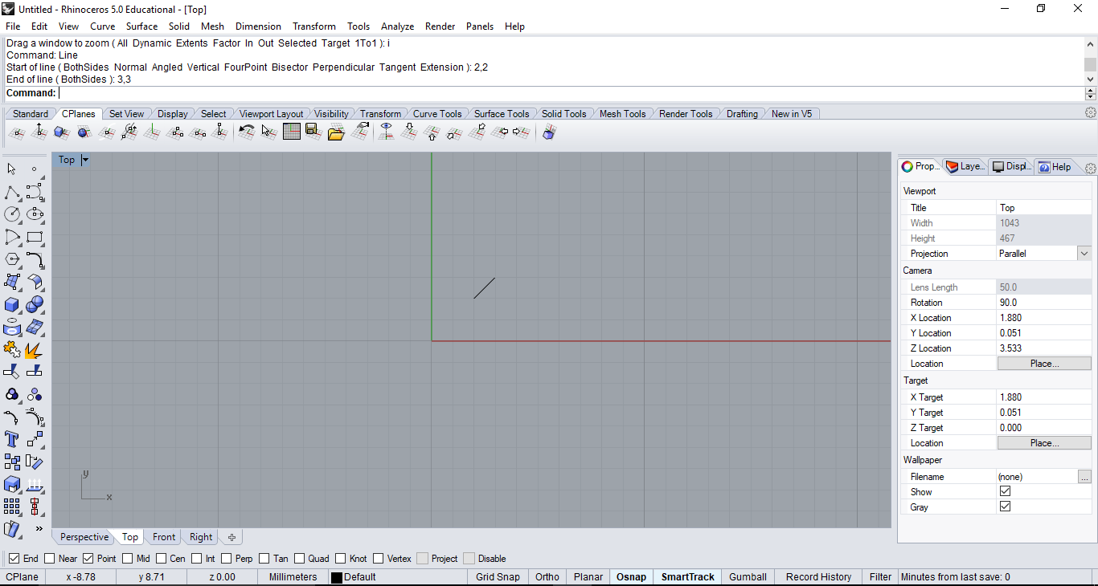

Slide 25



Intro to Computer assisted design
Draw a line
Only use one word at a time!
Error: Too many words
Notes:
25

Slide 26
Intro to computer assisted design
Line
OK.
First Point?
Notes:
26

Slide 27
Intro to computer assisted design
Coordinate Input Method 1:
Euclidean Coordinates
2,2
OK.
Second Point?
3,3
Done.
What’s next?
Notes:
27

Slide 28
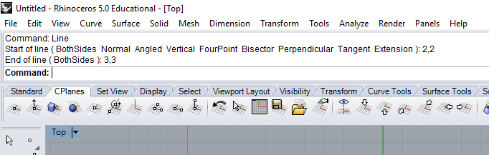

Slide 29
Intro to Computer assisted design
Coordinate Input Method 2:
Relative Coordinates
2,2
OK.
Second Point?
r1,1
Done.
What’s next?
Notes:
29

Slide 30
Intro to computer assisted design
Coordinate Input Method 3:
Polar Coordinates
3<45
OK.
Second Point?
2<270
Done.
What’s next?
Notes:
30

Slide 31
Intro to computer assisted design
Coordinate Input Method 4:
Relative Polar Coordinates
3<45
OK.
Second Point?
r3<270
Done.
What’s next?
Notes:
31

Slide 32
Coordinate options
Standard Coordinates: x,y
Relative Coordinates: rx,y
Polar Coordinates: d<θ
Relative Polar Coordinates: rd<θ
Notes:
32

Slide 33
Intro to computer assisted design
Rectangle
OK.
First Corner?
(3Point, Vertical, Center, Rounded)
C
Center of Rectangle?
3,5
Corner?
1,2
Notes:
33

Slide 34
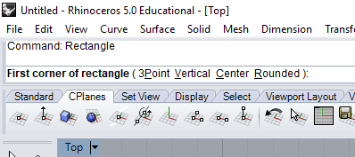

Slide 35
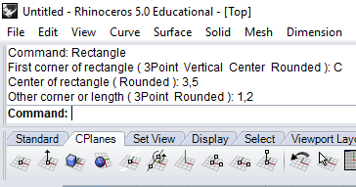

Slide 36
Key Rhino Commands
Creating Objects
  Point
  Line
  Circle
  Rectangle
  Arc
  Curve
  Polygon
  TextObject
  Polyline
Modifying Objects
  Copy
  Move
  Mirror
  Rotate
  Scale
  Trim
  Divide
  Array
  ArrayPolar
3D Commands
  Extrude
  Revolve
  Boolean Intersect
  Boolean Difference
  Boolean Union
Combining Objects
  Join/Explode
  Group/Ungroup
  Split
Notes:
After this slide, swiitch to Rhino to demo:
-4 methods for inputting coordinates
-Creating Rectangle
Emphasize Text input and text response. Is easier than the mouse.
Then model some modify commands. Now I will use the mouse to select objects.
Grip Snap, Osnap: only use one at a time
36

Slide 37
Mouse snap options
GripSnap
ObjectSnap
Midpoint
Point
Intersection
Endpoint
Tangent
…
Snap Tips:
Most options should be OFF.
Turn settings on as you need them.

Slide 38
Engraving or Cutting?

Slide 39
Curricular Integration
Without using the POLYGON command…
Make an equilateral triangle.
Make a regular pentagon.
Make a regular tetrahedron.
Find the centers of each of the above.
What does center even mean?
The possibilities for IBL and PBL are endless.

Slide 40

Check us out online!
http://robinsoncenter.uw.edu

Slide 41
Questions?
Slideshow and other resources available at
www.PaulGafni.com/IntroToRhino
Paul Gafni
gafnip@uw.edu
775 813 2486
Transition School Mathematics Instructor
Robinson Center for Young Scholars
http://robinsoncenter.uw.edu

